Slide 1
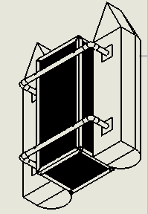
THE DESIGN OF A DEBRIS CLEARING VESSEL
Presented By:
Mohsin Mehmood
& Hafeez Shittu

Slide 2
Outline
Back ground
Project Objective
Design Requirements
Design Constraints
Design Approach
Tasks
Implementation
Conclusion

Slide 3
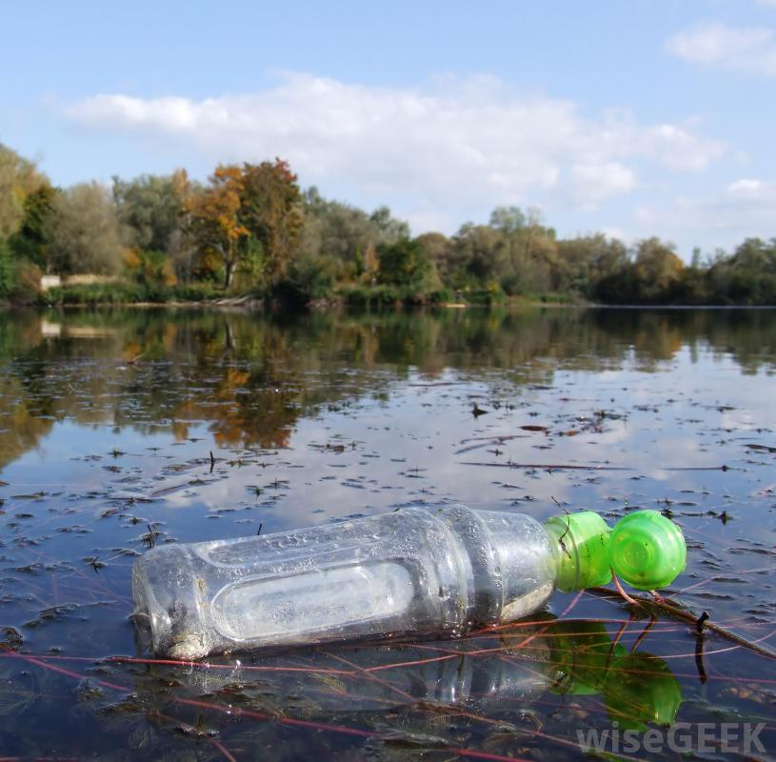
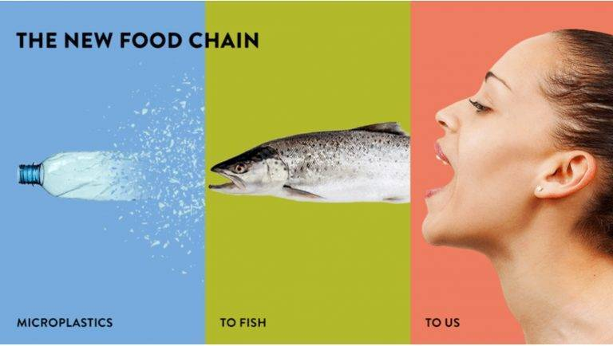
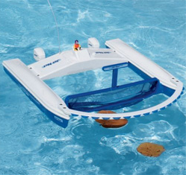
Background
Motivation
Plastics and its harmful effects.
Innovating Existing products.

Slide 4
Project Objective
The objective of this project is to design a Catamaran (Dual Hull) marine vessel capable of detecting plastic bottles using Target Recognition and collect them.

Slide 5
Design Requirements
The main frame of the vehicle should be able to support up to 60 lbs. of total load, including the Payload up to 20 lbs. and 25 lbs. of vehicle itself.
The motors should drive the vehicle with the velocity of 5 miles per hour.
The Design must be cost efficient.
Recognize floating plastic bottles using machine learning.
Should recognize the target (Volume 500ml, height 23.50cm, diameter 6.58, max weight .54kg and function intelligently.

Slide 6
Design Constraints
Budget
Visibility
Limited Resources.

Slide 7
Design Approach
Research Various Boat designs
Preliminary Boat designs
Weight Calculations
Hydrostatic study
Fluid dynamics calculations
CAD Simulation
Flow analysis
FEM analysis
Building a Prototype

Slide 8
Design Approach (Continued)
Autonomous System
Image Recognition
Electrical Component
Power Analysis

Slide 9
Tasks
Task 1: Research Various Boat designs
Task 2: Preliminary boat design
Task 3: Weight Calculations
Task 4: Hydrostatic evaluation
Task 5: Fluid dynamics evaluation
Task 6: CAD simulations
Task 7: Building the prototype
Task 1. Navigation strategy
Task 2. System design
Task 3. Power Analysis
Task 4. Autonomy Implementation
Task 5. Image Recognition System
Task 6. Image Recognition System Training

Slide 10
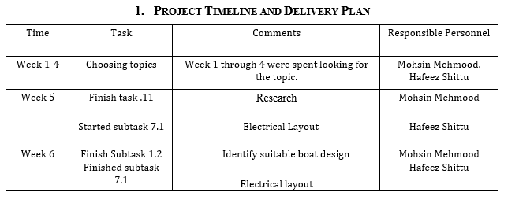
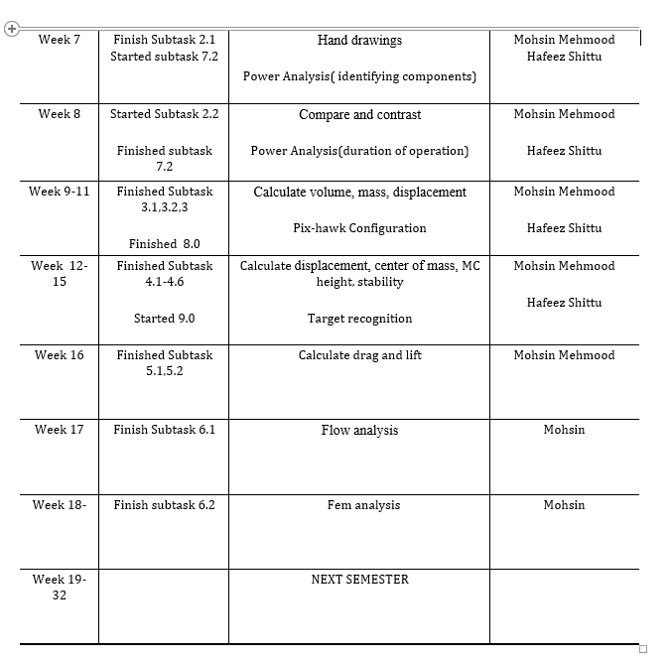
Project Timeline

Slide 11
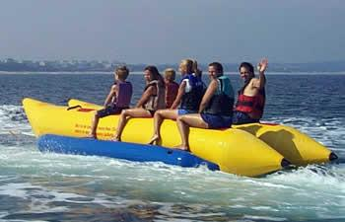
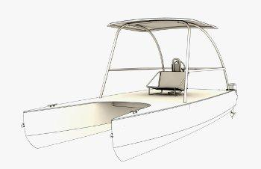
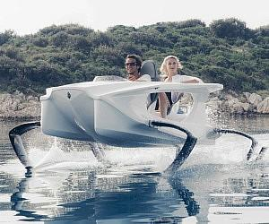
Implementation: (Task 1)
Research
Banana Boats
Hydrofoil boats
Catamaran Boats
Pontoons and its advantages:
Ease of Use/Maintenance
Building Cost and Storage
Longevity

Slide 12
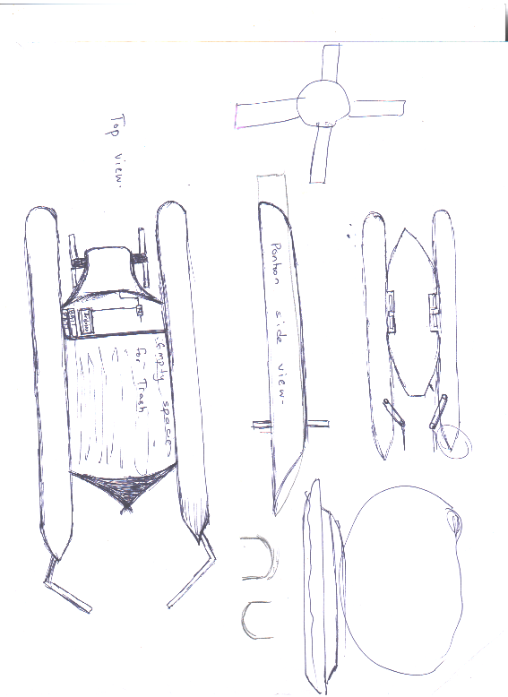
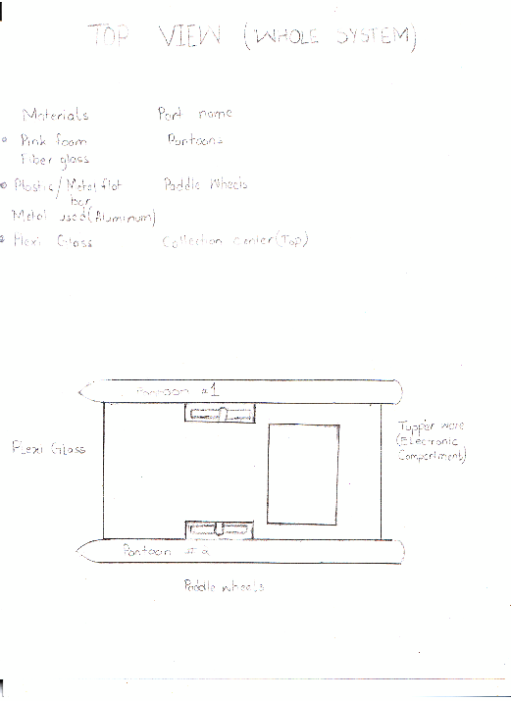
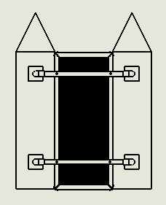
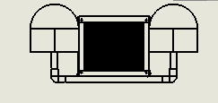
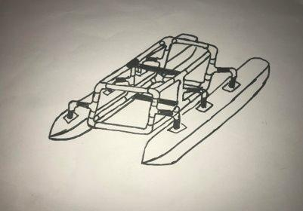
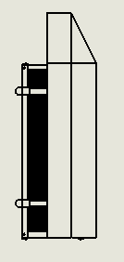
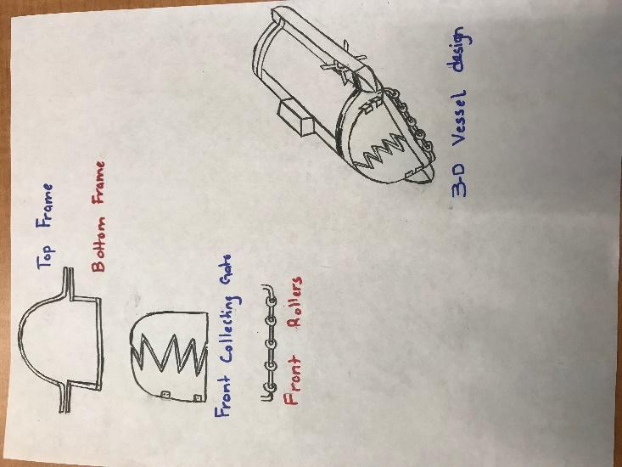
Implementation of Task 2.
Earlier designs:
Final Design:

Slide 13
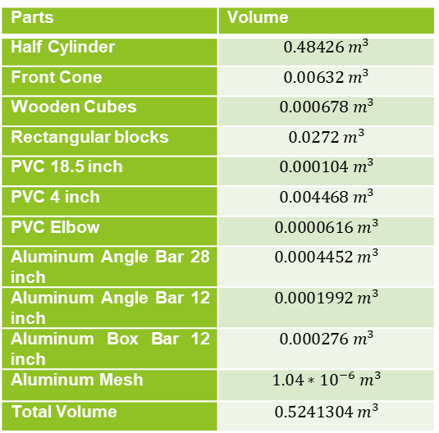
Implementation of Task 3
Total Volume Total Mass
Parts | Volume
Half Cylinder | $$0.48426 m^{3}$$
Front Cone | $$0.00632 m^{3}$$
Wooden Cubes | $$0.000678 m^{3}$$
Rectangular blocks | $$0.0272 m^{3}$$
PVC 18.5 inch | $$0.000104 m^{3}$$
PVC 4 inch | $$0.004468 m^{3}$$
PVC Elbow | $$0.0000616 m^{3}$$
Aluminum Angle Bar 28 inch | $$0.0004452 m^{3}$$
Aluminum Angle Bar 12 inch | $$0.0001992 m^{3}$$
Aluminum Box Bar 12 inch | $$0.000276 m^{3}$$
Aluminum Mesh | $$1.04∗{10}^{−6} m^{3}$$
Total Volume | $$0.5241304 m^{3}$$
Parts | Mass
Half Cylinder | 0.48426 kg
Front Cone | 0.13272 kg
Wooden Cubes | 0.92208 kg
Rectangular blocks | 0.5712 kg
PVC 18.5 inch | 0.1352 kg
PVC 4 inch | 0.058 kg
PVC Elbow | 0.08008 kg
Aluminum Angle Bar 28 inch | 0.120204 kg
Aluminum Angle Bar 12 inch | 0.538 kg
Aluminum Box Bar 12 inch | 0.752 kg
Aluminum Mesh | 2.85 kg
Screws | 0.117 kg
Total Mass | 6.760744 kg

Slide 14
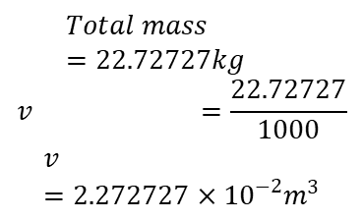
Implementation of task 4
Total Mass breakdown:
Total Water Displacement:
Height of Submerged Ship:
Total weight of the building materials = 6.760744 kg =>14.8736368 pounds
The mass of electronics = 10.17 pounds
Maximum Mass of the payload = 25 pounds
Total weight =22.72727 kg
$$Total mass =22.72727kg$$
$$v =\frac{22.72727}{1000}$$
$$v =2.272727×{10}^{−2}m^{3}$$

Slide 15
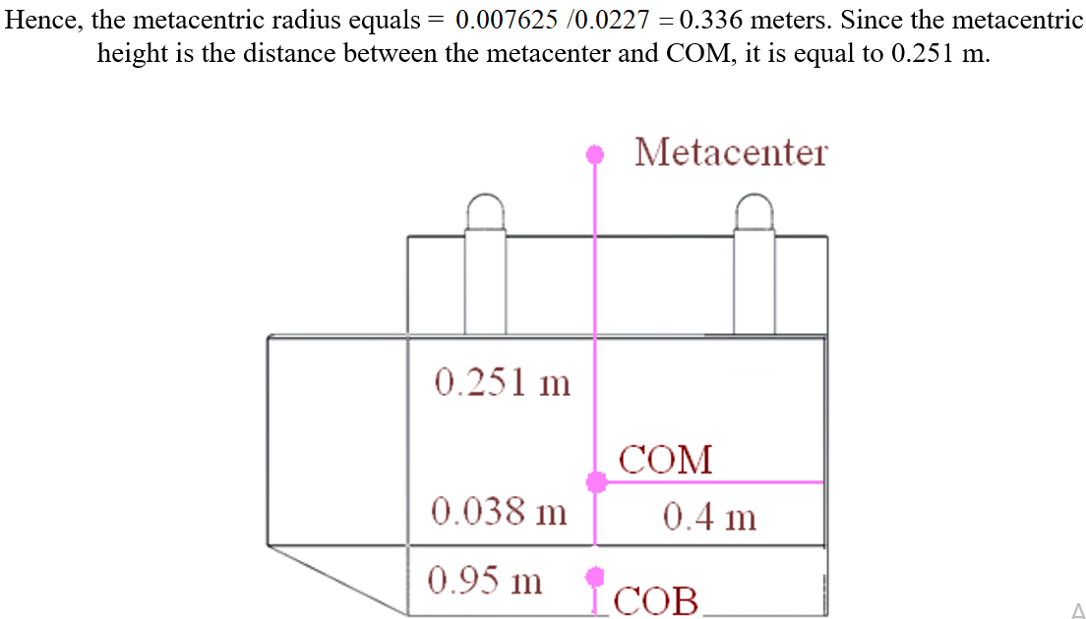
Task 4 Implementation (Cont)
Center of mass
Metacentric Height
Center of Buoyancy
Part | cubic meters | meters | meters | meters
Left semi-cone | 0.000931 | -0.1396 | 0.4295 | -0.0389
Right semi-cone | 0.000931 | 0.1396 | 0.4295 | -0.0389
Left semi-cylinder | 0.01043 | -0.1396 | 0 | -0.0475
Right semi-cylinder | 0.01043 | 0.1396 | 0 | -0.0475
Center of the buoyancy |  | 0 | 0.035203 | -0.0468
.

Slide 16
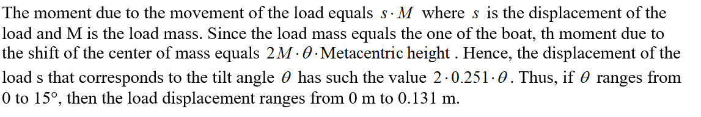
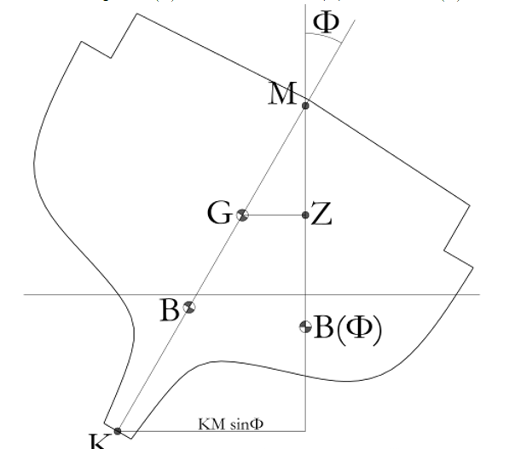
Task 4 Implementation (Cont)

Slide 17
Implementation of Task 5
To finding out the Drag and Lift forces that will be applied to the design while moving at the velocity of 5mph.
This will compute the fluid dynamics of the design.
We identified it by using flow simulation.
In this case, Lift force do not apply.

Slide 18
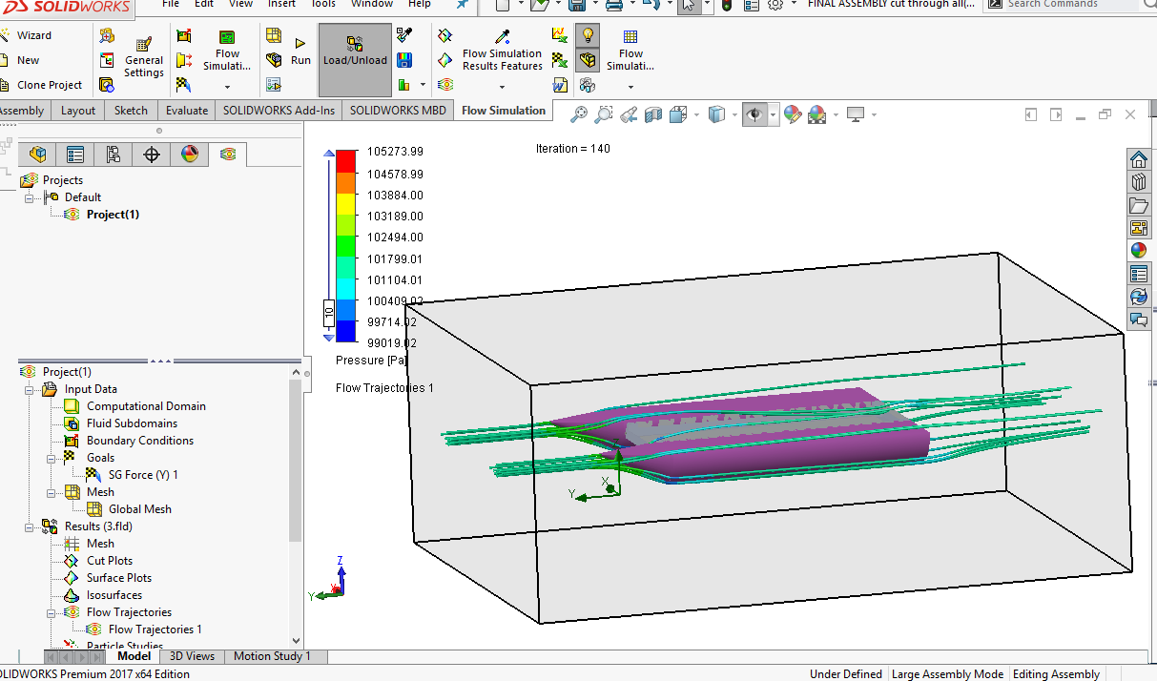
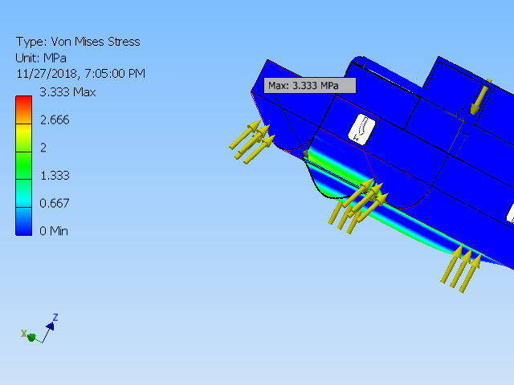
Implementation of Task 6
Flow simulation
This Calculated the drag force as 29.37 N
FEA Analysis
Name | Minimum | Maximum
Volume | 63527900 mm^3
Mass | 71.4218 kg
Von Mises Stress | 0.00000066323 MPa | 3.333 MPa
1st Principal Stress | -0.840666 MPa | 2.82522 MPa
3rd Principal Stress | -3.2432 MPa | 1.257 MPa
Displacement | 0 mm | 0.160998 mm
Safety Factor | 15 ul | 15 ul

Slide 19
Power Calculation Steps
Fist calculate Acceleration.
Use it to calculate Thrust force.
Use the force to Calculate power.
Determine RPM required by chosen prop.
Use RPM to identify motor.

Slide 20
Electrical Components
Raspberry pi 3
Camera
Micro SD card
Battery ( two 2s lipos)
Pixhawk
Ubec x2
Voltage regulator
Relay (DPDT)
Motor
Electronic Speed Converter (ESC)
Radio Controller & Receiver
Servo

Slide 21

Power Connection Layout
Battery
ESC
motor
Ubec
PI 3
Ubec
Pixhawk
Voltage regulator
Relay

Slide 22
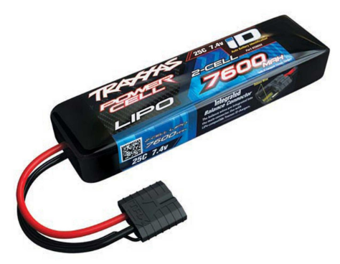
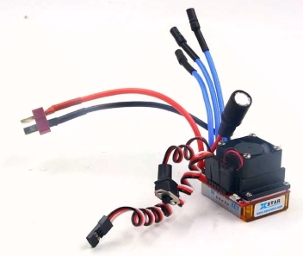
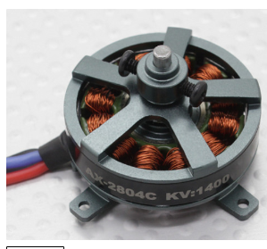
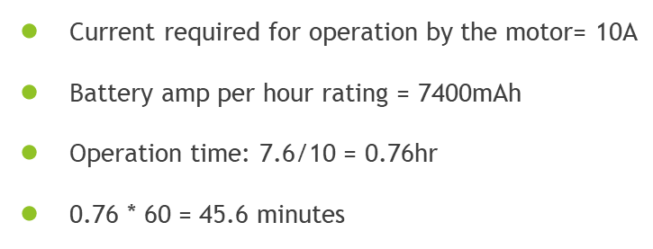
Power connection to the motor

Slide 23
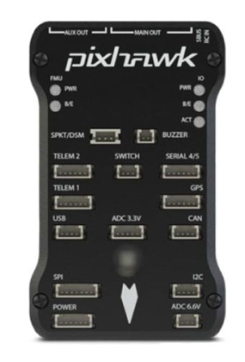
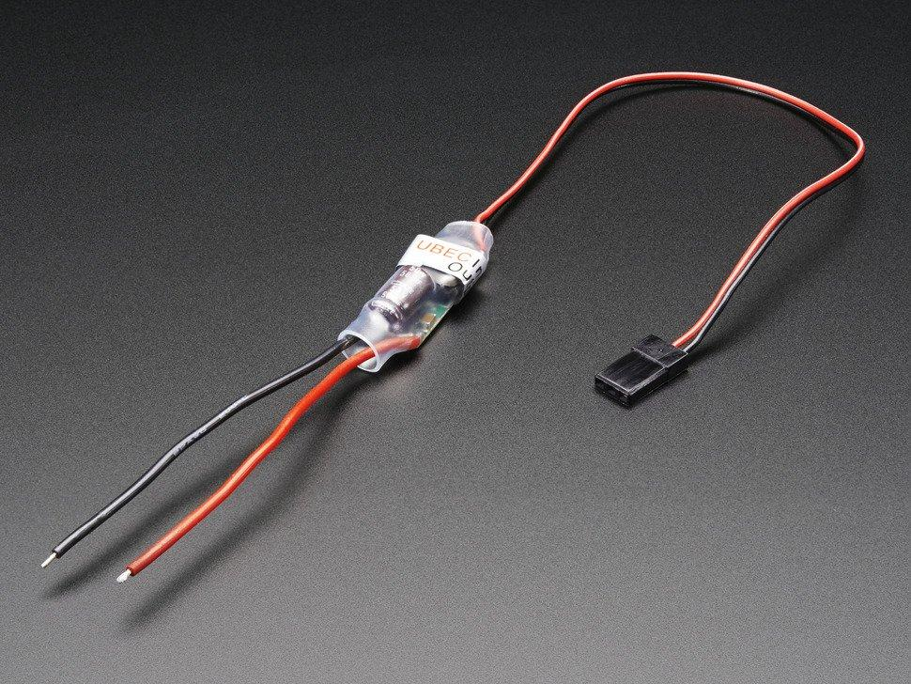
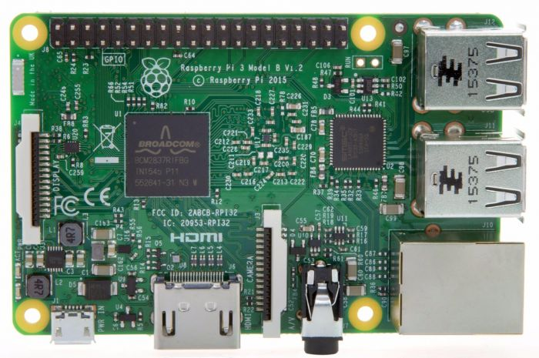
Power connection to micro controllers
The battery is connected in parallel to 2 ubec which is connected to the raspberry pi and pixhawk
The current required by the microcontroller are 2.5 and 2.25
Total current drawn = 4.75 A
Battery amp per hour rating = 7600mAh
Operation time: 7.6Ah / 4.75A = 1.6
Which is 1hr 36 mins

Slide 24
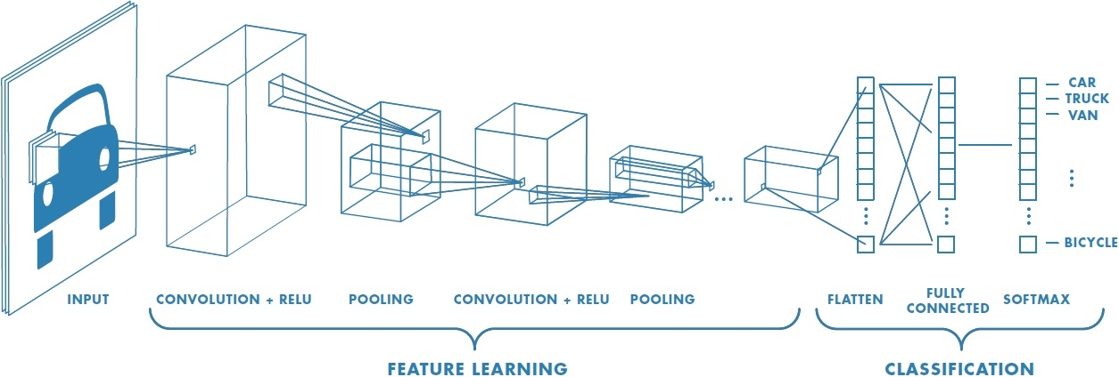
Image recognition Setup
Parameters are convoluted with filters to refine the values
Operations such as Pooling and striding are employed to manipulate the size of the convolution matrix
The arrays of the parameters are aligned to form a single in the classification section then compared to the softmax

Slide 25

parameter
Convolution (z = w-a+1)
Max pooling of 2 strides (w=a/2)
W=6x6
Z=4x4
1 | 7 | 5 | 8
1 | 5 | 9 | 3
1 | 6 | 7 | 8
3 | 5 | 8 | 3
*
A=3x3
7 | 9
6 | 8
Stride Convolution (v = (n-f)/s + 1 )
1 layer of a convolution neural network
$$Z^{\left[1\right]}=W^{\left[1\right]}a^{\left[0\right]}+b^{\left[1\right]}$$
W=7x7
Z=4x4
*
A=3x3

Slide 26
Edge detection using Convolution
5 | 5 | 5 | 0 | 0 | 0
5 | 5 | 5 | 0 | 0 | 0
5 | 5 | 5 | 0 | 0 | 0
5 | 5 | 5 | 0 | 0 | 0
5 | 5 | 5 | 0 | 0 | 0
5 | 5 | 5 | 0 | 0 | 0
0 | 15 | 15 | 0
0 | 15 | 15 | 0
0 | 15 | 15 | 0
0 | 15 | 15 | 0
1 | 0 | -1
1 | 0 | -1
1 | 0 | -1
*
*

Slide 27
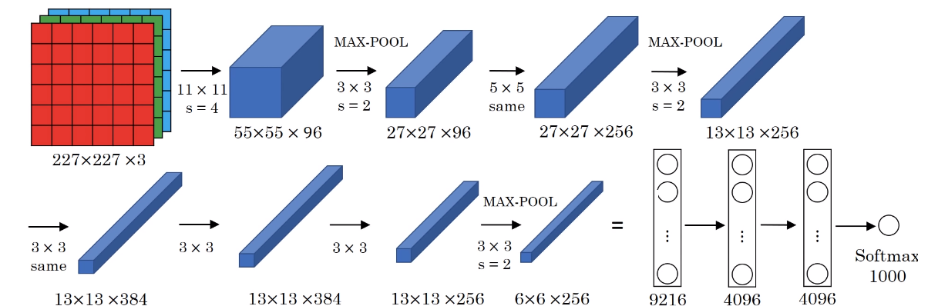
The inception neural network
Contains 8 layers
1,984 nodes
About 6 million parameters

Slide 28
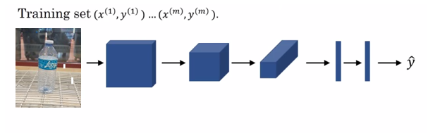
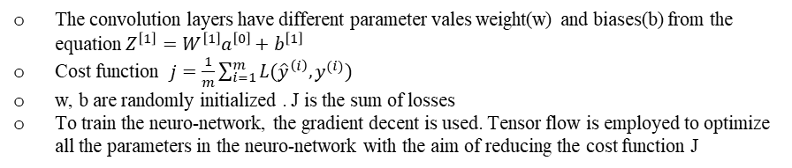
Parameter optimizer
The convolution layers have different parameter vales weight(w) and biases(b) from the equation $Z^{\left[1\right]}=W^{\left[1\right]}a^{\left[0\right]}+b^{\left[1\right]}$
Cost function $j=\frac{1}{m}\sum_{i=1}^{m}{L({\hat{y}}^{\left(i\right)},y^{(i)}) }$
w, b are randomly initialized . J is the sum of losses
To train the neuro-network, the gradient decent is used. Tensor flow is employed to optimize all the parameters in the neuro-network with the aim of reducing the cost function J

Slide 29
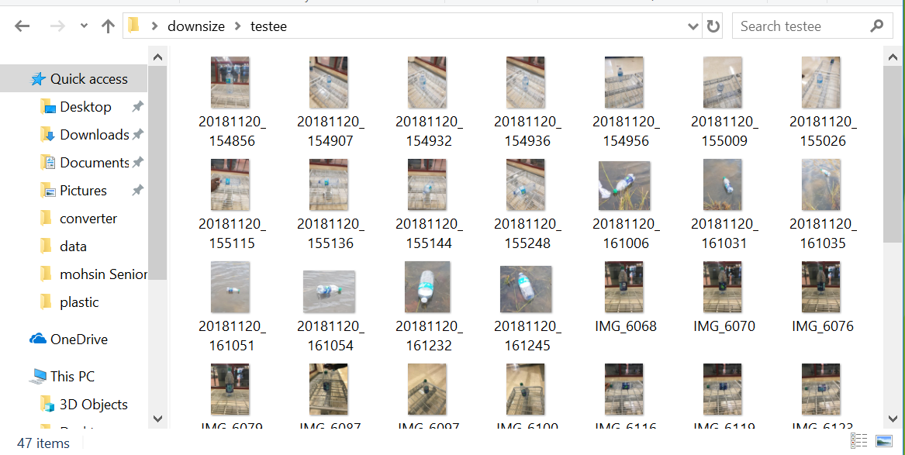
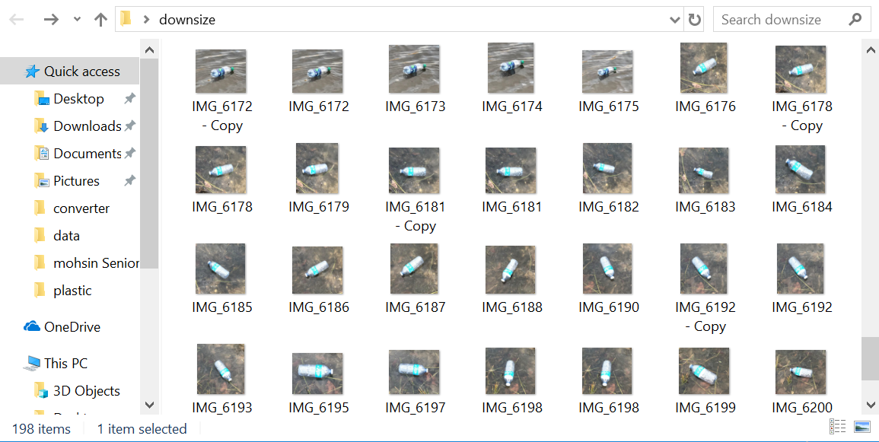
Dataset
Testing (47 pictures)
Training (198 pictures)

Slide 30
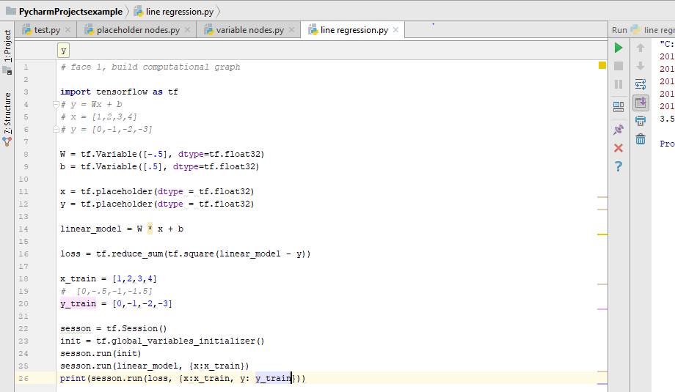
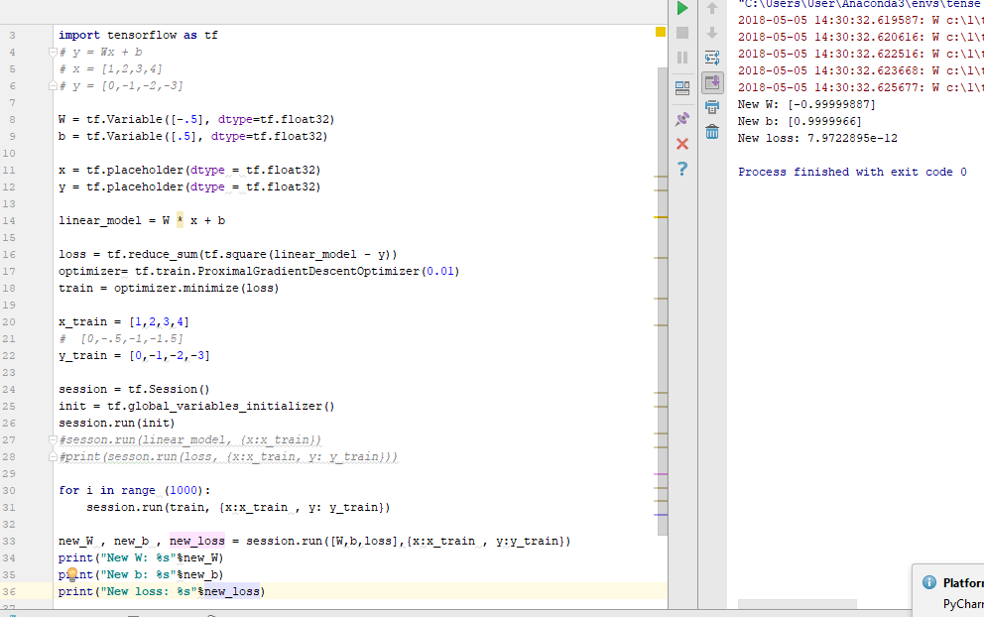
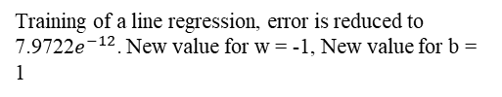
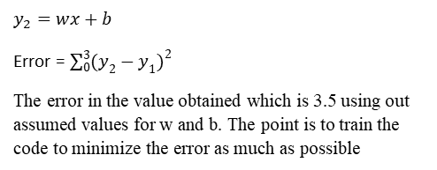
Optimization using TensorFlow
$$y_{2}=wx+b$$
Error = $\sum_{0}^{3}{{(y_{2}−y_{1})}^{2}}$
The error in the value obtained which is 3.5 using out assumed values for w and b. The point is to train the code to minimize the error as much as possible
Training of a line regression, error is reduced to 7.9722$e^{−12}$. New value for w = -1, New value for b = 1

Slide 31
Image recognition Setup
Hardware
Software
Raspberry pi 3
Webcam / pi cam
Micro SD card {containing the Rasbian OS}
A personal computer
Portable Power Supply
Wireless wifi dongle
Mouse
Keyboard
Update the raspberry pi
Install Tensorflow
Install OpenCV
Compile and install Protobuf
Set up Tensor flow directory Structure and the PYTHONPATH variable
Test the system

Slide 32
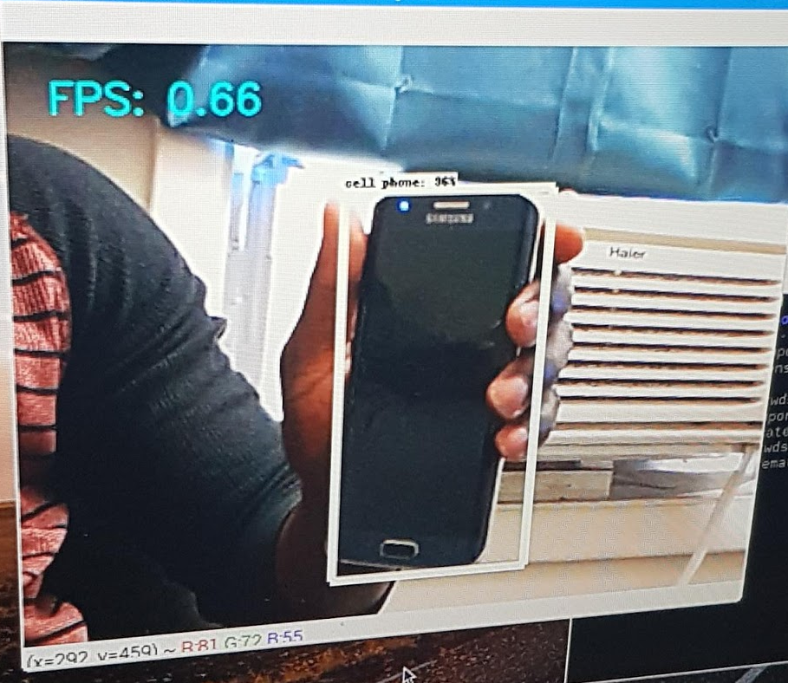
Test run of target recognition system
With the aid of a pre-trained object detecting model, I was able to detect my phone
At the bottom right are co-ordinate values which be used to stare the vessel after a bottom has been detected.

Slide 33
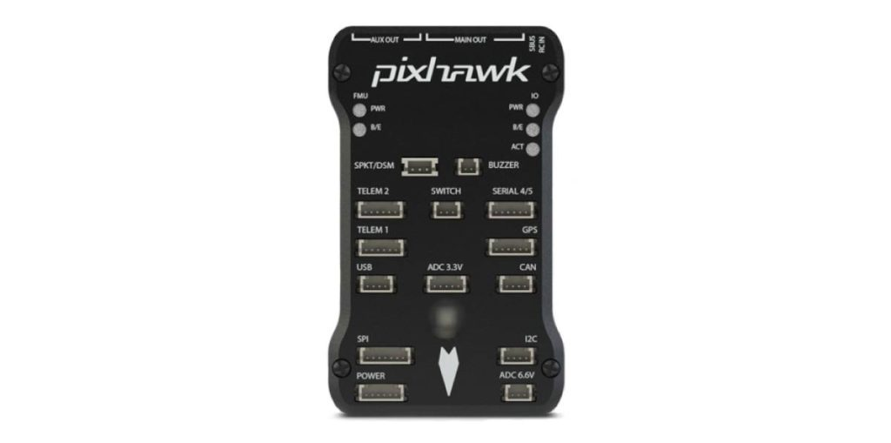
Pixhawk is autopilot micro controller
It will be the primary navigation of the whole system
Will be programmed to move the boat along the specific paths required by setting wave points with the mission planner software

Slide 34
system layout
Pixhawk
ESC
motor
Rc
Raspberry pi3
Servo
Pixhawk primary controls the vessel
An Rc is utilized for manual control
Raspberry pi is able to communicate with the pixhawk using the MAV link protocol over a serial port connection
Camera

Slide 35
Future Plan
Build the prototype
Questions?

